Slide 1

Mustaphat Bretius
Customer Churn Analysis

Slide 2
Problem
Describe the business problem and define the analytic approach to solving the problem.
What is the business problem?
Rep:
The business problem is churn the company is losing customers, several rivals that are constantly trying to steal customers.
Who are the stakeholders impacted by the problem?
Rep:
The stakeholders impacted by the problem is
the marketing team.
customer service team.

Slide 3
Why is this problem important to the organization?
Rep:
It is a big problem for the business if customers start unsubscribing it will cause it to go bankrupt wich clound cause damage to the business.

Slide 4
Methodology
The methods and data sources used for the analysis are the dataset I retrieved from the Kaggle and Jupyter notebooks to analyze the data; I first imported the libraries and the dataset and used the groupby function to group the columns and count the variables and the describe function to perform a description on some of the data.

Slide 5
Results
Present your results from Week 1 (June 8, 2020) and Week 2 (June 15, 2020) of the churn analysis. Present your findings using descriptive statistics, pivot tables, or visualizations. If appropriate, you might run statistical models. If so, share the results from the implemented model.

Slide 6
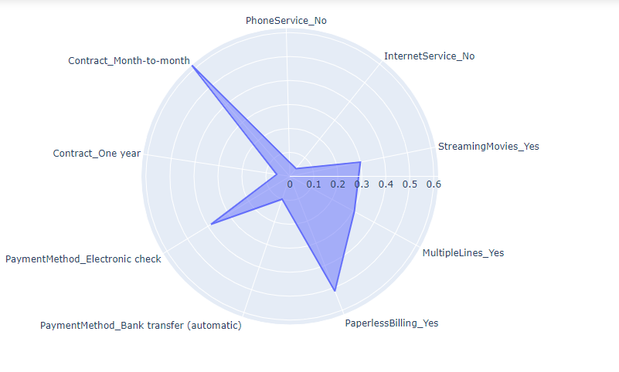
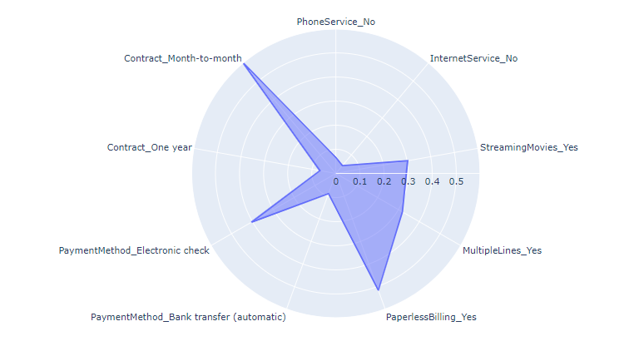
Results

Slide 7
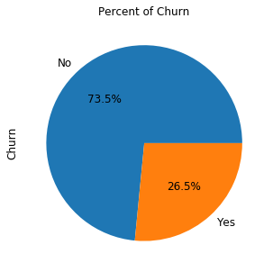
How much is churn affecting the business?
The churn affects the company compared to the 1869 customers who have unsubscribed
there are about 26 percent of people who have unsubscribed, so the company has lost a
large portion of its customers.

Slide 8
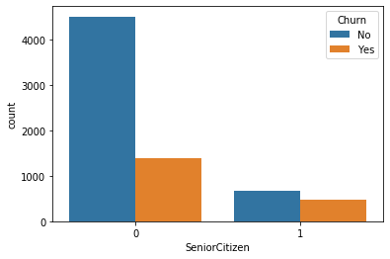
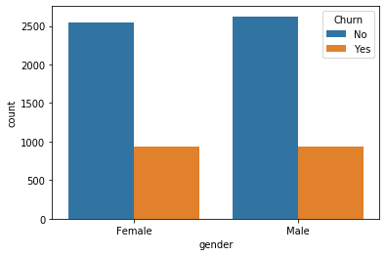
- Explain churn by the below categories A- Customer demographics like age and gender
In the case of desafectation there are more women who have unsubscribed.

Slide 9
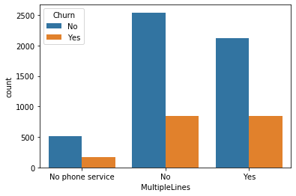
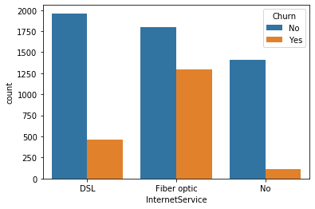
B- Services used
MultipleLines InternetService

Slide 10
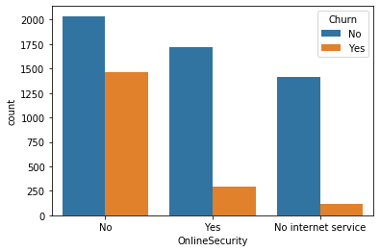
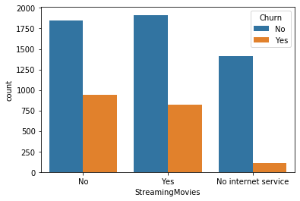
OnlineSecurity StreamingMovies

Slide 11
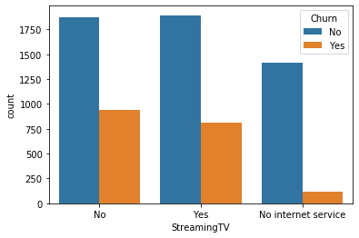
In the case of desafectation IntertnetService
StreamingTV

Slide 12
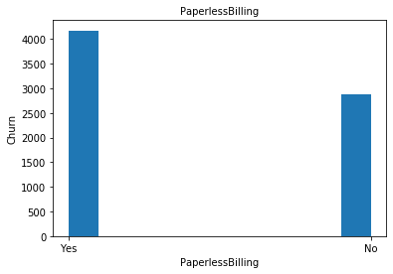
C-Billing information

Slide 13
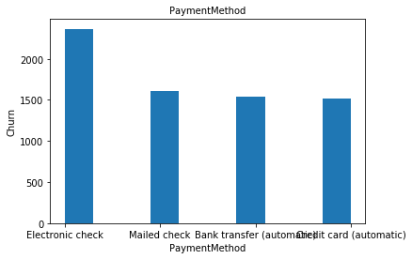
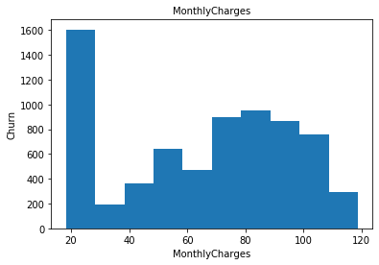

Slide 14
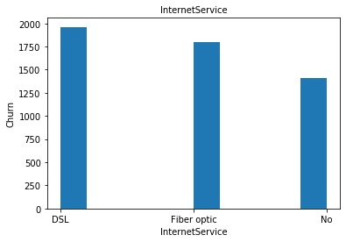
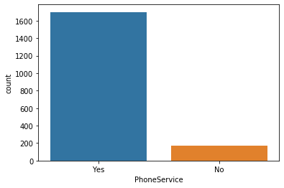
What services are typically purchased by customers who churned?
The services are typically purchased by customers who churned is Phoneservices and IternetServices

Slide 15
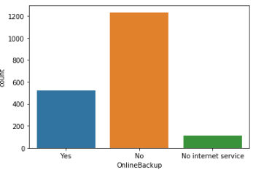
Are any services especially helpful in retaining customers?
Online backup

Slide 16
Discussion & Recommendations
Communicate your recommendations to your audience. Based on your results, how might you propose solving the business problem? (June 15, 2020)
What is your proposed solution?
What are strengths of the organization that you have leveraged in your solution?
This is The leading telecom company has a massive market share
This company has been the market leader for so many years
What are weaknesses of the organization that could undermine your solution?
There are not significant opportunities to grow with new customers

Slide 17
What are challenges that you might encounter? How can you mitigate them?
in spite of the new services much more satisfying proposed to the customers they will be able to be remaking not to be churn.
we will try to convince them with more concrete facts about marketing and advertising.

Slide 18
Communicate your recommendations to your audience. Based on your results, how might you propose solving the business problem?

Slide 19
What is your proposed solution?
The improvement of certain services
finds a way to retain clients who are not churn by offering them better service than before

Slide 20
References & Appendices
Provide citations for your work and provide resources for your audience to learn more about the technical aspects of your project. Share links to your GitHub repository or accompanying spreadsheets.

Slide 21
References & Appendices
https://github.com/Bretius/Churn_Project/blob/master/BretiusMustaphat_projetIBM.ipynb

